Slide 1
Angular Routing and Navigation

Slide 2
Why Routing is Necessary
Routing helps in directing users to different pages.
Users are provided different options in main page.
Based on the option they choose the target angular component will be rendered.

Slide 3
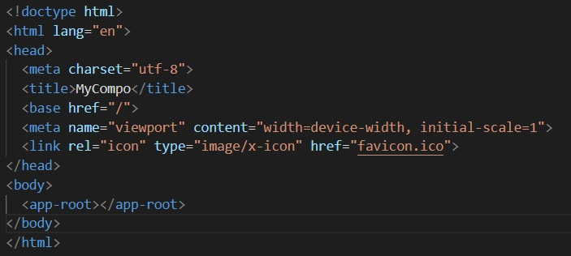
Define routes for pages
Most routing applications should add a <base > element to the index.html as the first child in the <head> tag to tell the router how to compose navigation URLs.
So, Add the base reference tag in the index.html file.

Slide 4
Define routes for pages
Before we define routes for the pages. Let’s define different component that we will call in routing.
ng generate component home
ng generate component test1
ng generate component test2
ng generate component test3

Slide 5
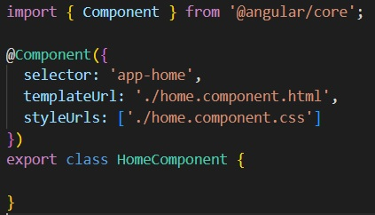
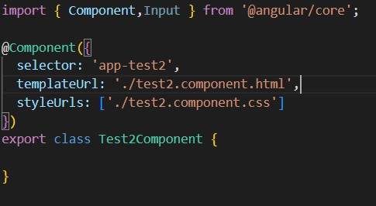
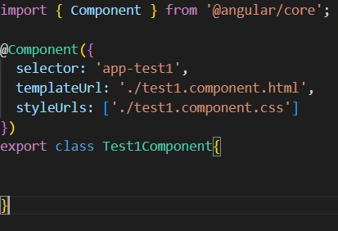
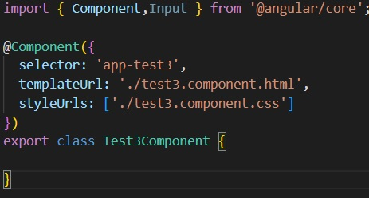
Define routes for pages

Slide 6
Define routes for pages
Download and save any three images of birds into the folder src/assets/images
“images” folder is a default folder, we need to create it.

Slide 7
Define routes for pages
test1.component.html
<p>test1 works!</p>
<img src="../../assets/images/bird1.jpg" width="200px" height="200px">
test2.component.html
<p>test2 works!</p>
<img src="../../assets/images/bird3.jpg" width="200px" height="200px">
test3.component.html
<p>test3 works!</p>
<img src="../../assets/images/bird4.jpg" width="200px" height="200px">
home.component.html
<p>home works!</p>

Slide 8
Create CSS(app.component.css)
.myclass{
float: left;
width: 30%;
background-color: grey;
height: 700px;
text-shadow: brown;
color: red;
font-size: 40px;
font-weight: bold;
align-items: center;
}
.myclass li:hover{
background-color: chartreuse;
font-style: italic;
}
.myclass ul {
margin-top: 20px;
padding: 20px;
height: 75px;
border: 1px solid black;
background: red;
position: relative;
align-items: center;
}
.myclass li {
background-color: lightblue;
border: 1px solid green;
height: 75px;
list-style-type: none;
margin-left: 20px;
padding: 20px;
width: 30%;
}
.myclass a{
text-decoration: none;
}
.myclass ul,li{
list-style-type: none;
box-shadow: inset;
border:brown;
border-color: blueviolet;
}
.myclass2{
float: left;
width: 55%;
background-color: #ddd;
height: 700px;
text-align: center;
font-size: 50px;
font-weight: bold;
}
img{
width: 50px;
height: 50px;
}

Slide 9
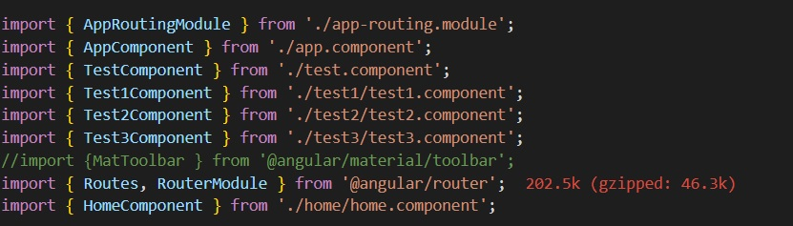
Define routes for pages
Next, we need to import the components in app.module.ts

Slide 10
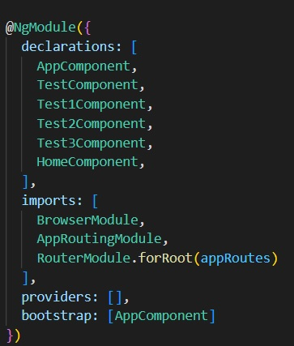
Define routes for pages
Step3: Add Components to be part of declarations under @NgModule

Slide 11
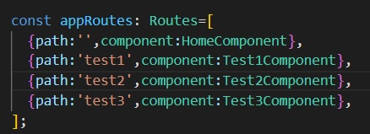
Define routes for pages
Step 4: Add routing path information in the app.module.ts

Slide 12
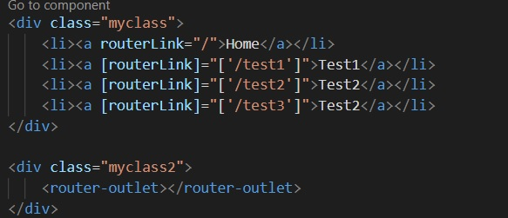
Final Embedding
Step 5:Finally, we need to add components in app.component.html file

Slide 13
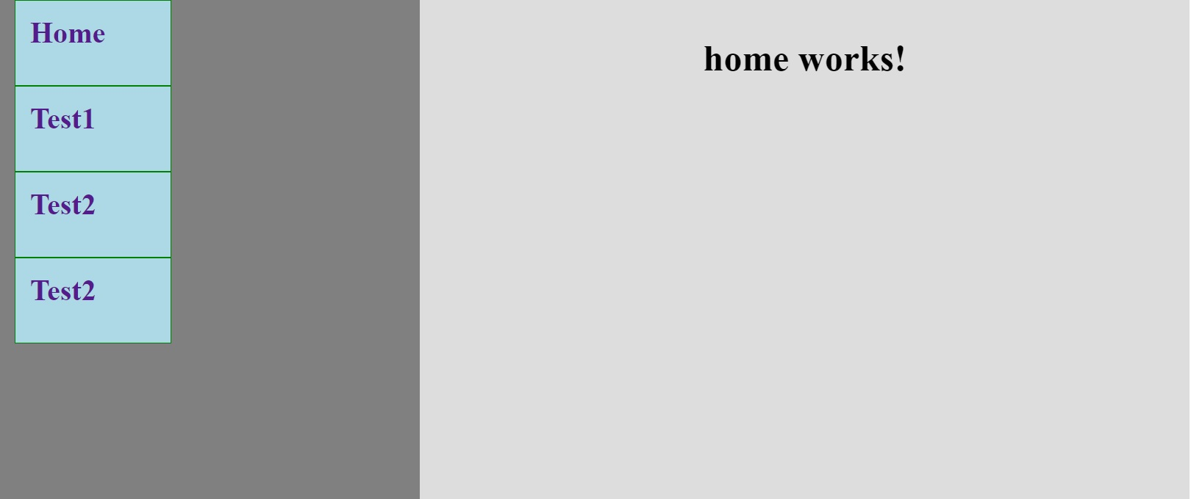
Run the application
Command prompt type:
ng serve --open

Slide 14
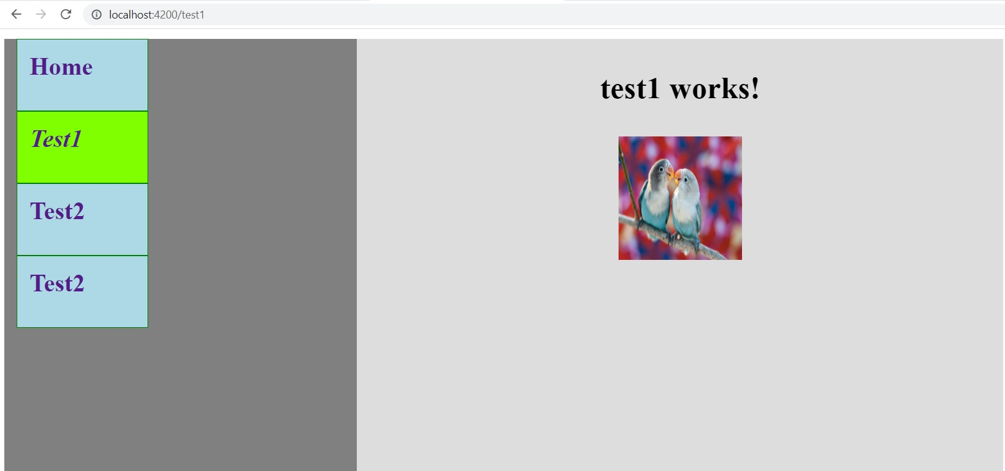
Run the application

Slide 15
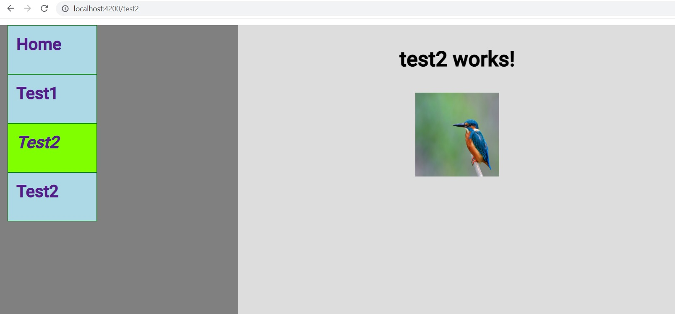
Run the application

Slide 16
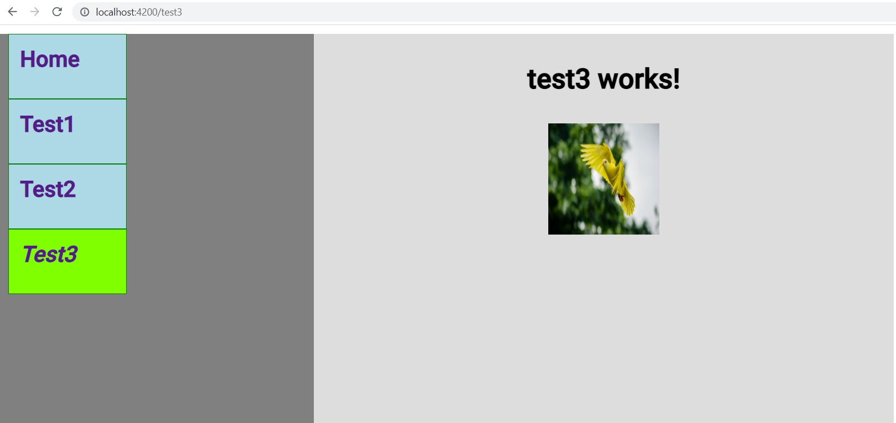
Run the application

